Slide 1
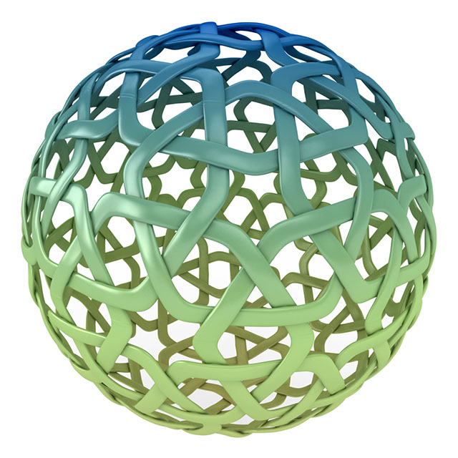
CIPIL conference: Mens Rea in Intellectual Property
Intention and Knowledge in Remedies for
Infringement of IPRs
David Stone
Cambridge, 9 March 2019

Slide 2
Article 3(2) of the Enforcement Directive (2004/48/EC)
Member States shall provide for the measures, procedures and remedies necessary to ensure the enforcement of the intellectual property rights covered by this Directive. Those measures, procedures and remedies shall be fair and equitable and shall not be unnecessarily complicated or costly, or entail unreasonable time-limits or unwarranted delays.
Those measures, procedures and remedies shall also be effective, proportionate and dissuasive and shall be applied in such a manner as to avoid the creation of barriers to legitimate trade and to provide for safeguards against their abuse.

Slide 3
Article 45 Agreement on Trade-Related Aspects of Intellectual Property Rights (TRIPS)
Damages
(1) The judicial authorities shall have the authority to order the infringer to pay the right holder damages adequate to compensate for the injury the right holder has suffered because of an infringement of that person’s intellectual property right by an infringer who knowingly, or with reasonable grounds to know, engaged in infringing activity.
(2) The judicial authorities shall also have the authority to order the infringer to pay the right holder expenses, which may include appropriate attorney’s fees. In appropriate cases, Members may authorize the judicial authorities to order recovery of profits and/or payment of pre-established damages even where the infringer did not knowingly, or with reasonable grounds to know, engage in infringing activity.

Slide 4
Article 13 of the Enforcement Directive (2004/48/EC)
Damages
(1) Member States shall ensure that the competent judicial authorities, on application of the injured party, order the infringer who knowingly, or with reasonable grounds to know, engaged in an infringing activity, to pay the rightholder damages appropriate to the actual prejudice suffered by him/her as a result of the infringement.
  When the judicial authorities set the damages:
  (a) they shall take into account all appropriate aspects, such as the negative economic consequences, including lost profits, which the injured party has suffered, any unfair profits made by the infringer and, in appropriate cases, elements other than economic factors, such as the moral prejudice caused to the rightholder by the infringement; or
  (b) as an alternative to (a), they may, in appropriate cases, set the damages as a lump sum on the basis of elements such as at least the amount of royalties or fees which would have been due if the infringer had requested authorisation to use the intellectual property right in question.
(2) Where the infringer did not knowingly, or with reasonable grounds know, engage in infringing activity, Member States may lay down that the judicial authorities may order the recovery of profits or the payment of damages, which may be pre-established.

Slide 5
Intellectual Property Enforcement Regulations 2006
Assessment of damages
3.(1) Where in an action for infringement of an intellectual property right the defendant knew, or had reasonable grounds to know, that he engaged in infringing activity, the damages awarded to the claimant shall be appropriate to the actual prejudice he suffered as a result of the infringement.
(2) When awarding such damages—
(a) all appropriate aspects shall be taken into account, including in particular—
  (i) the negative economic consequences, including any lost profits, which the claimant has suffered, and any unfair profits made by the defendant; and
  (ii) elements other than economic factors, including the moral prejudice caused to the claimant by the infringement; or
(b) where appropriate, they may be awarded on the basis of the royalties or fees which would have been due had the defendant obtained a licence.

Slide 6
Section 97(1) Copyright, Designs and Patents Act 1988
Provisions as to damages in infringement action
(1) Where in an action for infringement of copyright it is shown that at the time of the infringement the defendant did not know, and had no reason to believe, that copyright subsisted in the work to which the action relates, the plaintiff is not entitled to damages against him, but without prejudice to any other remedy.

Slide 7
Overview of damages/ account for innocent infringement
IP Right | Damages for innocent infringement | A/C of profits for innocent infringement
Copyright | No | Yes
Trade marks | Yes | Yes
Patents | No | No
Unregistered designs | No | Yes
Registered designs | No | ?
Performer’s rights | No | Yes

Slide 8
Section 97(2) Copyright, Designs and Patents Act 1988
The court may in an action for infringement of copyright having regard to all the circumstance, and in particular to-
(a) the flagrancy of the infringement; and
(b) any benefit accruing to the defendant by reason of the infringement,
award such additional damages as the justice of the case may require.

Slide 9
Phonographic Performance Limited v Andrew Ellis trading as Bla Bal Bar [2018] EWCA Civ 2812
Lewison LJ:
“damages awarded under s97(2) “do not need to be shoehorned into existing general legal taxonomy”
“Their legal character is sui generis”

Slide 10
Article 13 of the Enforcement Directive (2004/48/EC)
Damages
(1) Member States shall ensure that the competent judicial authorities, on application of the injured party, order the infringer who knowingly, or with reasonable grounds to know, engaged in an infringing activity, to pay the rightholder damages appropriate to the actual prejudice suffered by him/her as a result of the infringement.
  When the judicial authorities set the damages:
  (a) they shall take into account all appropriate aspects, such as the negative economic consequences, including lost profits, which the injured party has suffered, any unfair profits made by the infringer and, in appropriate cases, elements other than economic factors, such as the moral prejudice caused to the rightholder by the infringement; or
  (b) as an alternative to (a), they may, in appropriate cases, set the damages as a lump sum on the basis of elements such as at least the amount of royalties or fees which would have been due if the infringer had requested authorisation to use the intellectual property right in question.
(2) Where the infringer did not knowingly, or with reasonable grounds know, engage in infringing activity, Member States may lay down that the judicial authorities may order the recovery of profits or the payment of damages, which may be pre-established.

Slide 11
John Walmsley v Education Limited t/a Oise Cambridge [2014] WL 2194626
HHJ Melissa Clarke
Having said that, I do not think this is a flagrant breach for which it is appropriate for me to
order further damages for the following reasons. First, I do not think the Defendant's actions show the
element of intent or wilful negligence that is envisaged by the word “flagrant”. As I have said, I think its actions and those of the employee were naive and possibly one might be unkind enough to say pretty stupid, but I accept Ms Roberts' submissions that there was nothing more than that and there is no other evidence to point to flagrancy. Secondly, the purpose of an award of damages for copyright infringement is to compensate the copyright holder and put him in the position that he would have been in but for the breach of his rights. The Claimant here is in the business of creating photographs and selling licence fees in them and the Defendant's actions have not, as far as I can judge, caused them to benefit from any financial windfall nor for the Claimant's business to suffer more than in the normal course – the Defendant is not a competing business for example. In saying that I bear in mind that the Defendant's publication of the images was on a blog aimed at their students and not on their main commercial website. For those reasons, I am not going to award further damages by way of an additional uplift on the l
icence fee or otherwise and I consider the damages that I have already arrived at sufficient to
compensate the Claimant for the infringement suffered.

Slide 12
What do you need to establish flagrancy?
SCANDALOUS CONDUCT
DELIBERATE AND CALCULATED infringement
INTENTION
CONSPICUOUS BEHAVIOUR
KNOWLEDGE
COULDN’T CARE LESS
CONCEALMENT
Continuing infringement in the face of an injunction
Overall flagrancy is more concerned with chastising a defendant, than compensating a claimant. Additional damages are punitive in nature.

Slide 13
Conduct that is not sufficient for flagrancy
An honest, genuine and naïve mistake is not flagrant
Lawfully pushing legal boundaries does not, without more, constitute flagrancy.
The defendant’s fair belief that he is not infringing implies no flagrancy, even in the face of a claim.
The degree of copying (11%) might be insufficient to cause the exercise of the judge’s discretion to award additional damages

Slide 14
Article 13 of the Enforcement Directive (2004/48/EC)
Damages
(1) Member States shall ensure that the competent judicial authorities, on application of the injured party, order the infringer who knowingly, or with reasonable grounds to know, engaged in an infringing activity, to pay the rightholder damages appropriate to the actual prejudice suffered by him/her as a result of the infringement.
  When the judicial authorities set the damages:
  (a) they shall take into account all appropriate aspects, such as the negative economic consequences, including lost profits, which the injured party has suffered, any unfair profits made by the infringer and, in appropriate cases, elements other than economic factors, such as the moral prejudice caused to the rightholder by the infringement; or
  (b) as an alternative to (a), they may, in appropriate cases, set the damages as a lump sum on the basis of elements such as at least the amount of royalties or fees which would have been due if the infringer had requested authorisation to use the intellectual property right in question.
(2) Where the infringer did not knowingly, or with reasonable grounds know, engage in infringing activity, Member States may lay down that the judicial authorities may order the recovery of profits or the payment of damages, which may be pre-established.

Slide 15
Questions?
These are presentation slides only. The information within these slides does not constitute definitive advice and should not be used as the basis for giving definitive advice without checking the primary sources.
Allen & Overy means Allen & Overy LLP and/or its affiliated undertakings. The term partner is used to refer to a member of Allen & Overy LLP or an employee or consultant with equivalent standing and qualifications or an individual with equivalent status in one of Allen & Overy LLP’s affiliated undertakings.
LT:21782655.2

