Slide 1
EU Antitrust Law’s Resilience:
The Good, the Bad, and the Ugly
Dr Andriani Kalintiri
Senior Lecturer in Competition Law
CELS Lunchtime Seminar Series,
20 November 2024

Slide 2
Is EU antitrust law resilient in the face of change?

Slide 3
Legal Resilience

Slide 4
Law and change
Substantive and procedural norms are grounded in certain assumptions and reflect a certain balance of harms, risks and powers. Once adopted, they are deemed effective to maintain the envisioned balance.
BUT the world changes…

Slide 5
Legal resilience – Definition
Absorption
The assumptions and the balance of harms, risks and powers in the existing legal framework remain valid and appropriate, and the applicable substantive and procedural norms are effective.
Adaptation
The assumptions and the balance of harms, risks and powers in the existing legal framework are still valid and appropriate, but the applicable substantive and/or procedural norms must be modified to remain effective.
Transformation
The assumptions and the balance of harms, risks and powers in the existing legal framework are not valid or appropriate and the applicable substantive and/or procedural norms must be modified to become effective.

Slide 6
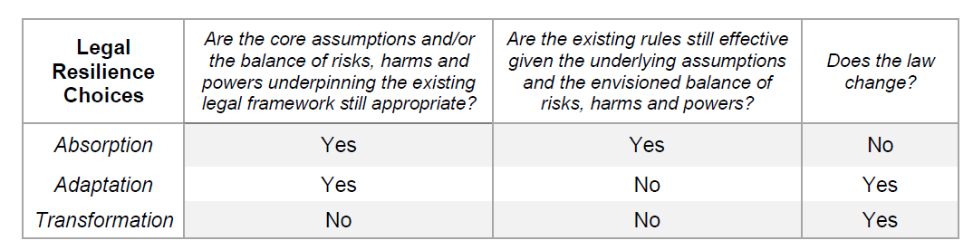
Legal resilience – Definition

Slide 7
Legal resilience – Assessment
Design features
To what extent do the design features of the existing substantive and procedural framework allow decision-makers to make absorption, adaptation and transformation choices, as needed (subject to the limits of their function)?
(a) Goals, substantive norms and evidence rules
(b) Information gathering, stakeholder engagement and intervention mechanisms
Resilience choices
To what extent are the resilience choices that decisionmakers make by employing the design features of the legal system in question justifiable?
The three dimensions of legal resilience are not inherently positive or negative. Which resilience choice – absorption, adaptation or transformation – is most justifiable depends (among others) on (a) the problem/change at hand; and (b) any implications of the possible response for (i) legal certainty; (ii) legal coherence; and (iii) legitimacy.

Slide 8
Design features

Slide 9
Resilience capabilities (I)
Goals, substantive norms and evidence rules
malleable normative scope (Stylianou and Iacovides, ‘The goals of EU competition law: a comprehensive empirical investigation’ (2022) 42(4) Legal Studies)
open texture of Articles 101 and 102 TFEU
requirement for contextual analysis – methodological gateway for accommodating shifts and integrating the particularities of different markets and sectors in the legal assessment, thus tempering the horizontality of the EU antitrust prohibitions
no actual harm needed for intervention – ‘precautionary’ enforcement possible in response to negative consequences that have not materialised yet
reliance on economics – integration of economic epistemic developments within the legal system (e.g., ‘more economic’ approach)

Slide 10
Resilience capabilities (I)
Information gathering, stakeholder engagement and intervention mechanisms
e.g., power to conduct investigations and sector inquiries; leniency policy; cartel settlements; formal and informal complaints; market testing of remedies; publication of soft law documents following public consultations – which allow for the integration of contemporary knowledge and the development of consensus positions
e.g., power to accept commitments; power to impose reactive remedies and proactive remedies; power to adopt findings of inapplicability with respect to specific practices ‘where the Community public interest (…) so requires’, as well as informal guidance in cases which ‘present novel or unresolved questions’ for the application of Articles 101 and 102 TFEU; decentralised enforcement regime envisioned by Regulation 1/2003 and ECN + Directive

Slide 11
Resilience vulnerabilities (I)
Goals, substantive norms and evidence rules
contested relevance of non-economic considerations – BUT in an ever-complex world where activities and spheres of life are interconnected, harms with potential competition relevance might slip through the cracks of the law
EU antitrust law requires a high degree of knowledge about the nature of the harm and its impact, inferred or established on the facts subject to the ‘firm conviction’ standard of proof → BUT complex problems are characterised by lack of sufficient knowledge and consensus, and risks may be high-impact but low-probability
focus on distinct harmful acts – BUT harm may be (a) the cumulative result of multiple acts by the same undertaking, within or across markets, each one of which may not be (as) harmful on its own (‘harmful strategies’) or (b) the cumulative result of multiple acts by multiple undertakings each one of which may not be illegal

Slide 12
Resilience vulnerabilities (I)
Goals, substantive norms and evidence rules
requirement for a causal link between the contested act and the harm – BUT in circumstances characterised by uncertainty and complexity the relationship between a conduct and the outcome may not be linear or easily traceable and it may not be easy or possible to determine the counterfactual
economic assumptions, concepts, theories and methods may turn into legal assumptions, concepts, theories and methods – BUT they may no longer be valid or suitable (e.g., criticisms against the ‘more economic’ approach insofar as it is inspired from neoclassical economics)
‘relevant market’ vs ecosystems
‘dominance’ as power over prices and outputs vs ‘gatekeeper power’
presumption of rationality vs consumer biases

Slide 13
Resilience vulnerabilities (II)
Information gathering, stakeholder engagement and intervention mechanisms
it takes time which may be short
the gathered information may not be helpful or objective or representative of all viewpoints and interests – risks of lobbying in EU competition policy and obstacles to adequate and effective citizen participation
existing intervention mechanisms are subject to constraints: e.g. interim measures –demonstrating a prima facie violation of Articles 101 and 102 TFEU will be practically infeasible in novel situations and in the face of uncertainty about the nature and likelihood of the harm; commitments – only an option when the undertakings consent to their imposition; remedial powers – neither limitless nor invariably effective (e.g., where the harm may be the result of a harmful strategy rather than a single harmful act or the cumulative result of multiple actors’ behaviour that lies beyond the infringer’s control or where the market has already tipped)
NOTE: Commission Staff Working Document, Evaluation of Regulations 1/2003 and 773/2004 (6 September 2024), SWD(2024) 216 final

Slide 14
Resilience choices

Slide 15


Examples (I)
COVID-19 – Resilience as absorption and adaptation
ECN Joint Statement on Corona Crisis (March 2020); Antitrust COVID Temporary Framework – (April 2020-October 2022); two comfort letters (2020 and 2021)
Updated Informal Guidance Notice: (a) added criterion of relevance for achieving the Commission’s priorities and Union interest and (b) expansion of meaning of ‘novel or unresolved question’ to include questions for which ‘there is no sufficient clarity’
Market and supply chain resilience references in revised HCG
Climate change – Resilience as adaptation
Added chapter on sustainability agreements in revised HCG to ensure effectiveness of existing legal framework, including various ‘tweak’s, such as broad definition of sustainability, safe harbours, notion of ‘collective benefits’ etc.

Slide 16

Examples (II)
Digitalisation – Resilience as transformation?
New assumptions, moving away from neoclassical economics?
  market definition still an integral part of antitrust analysis but limitations of SSNIP test, ‘interconnectedness’ and complementarity of markets and ‘digital ecosystems’, need to consider a firm’s ‘overall strategy’ and for a ‘multi-level or multi-directional’ and ‘more detailed’ examination to assess power and harm duly noted (e.g., Google Android)
  ‘new’ relevant factors for assessing market power and harm: significant upfront investments, access to data, direct and indirect network effects and feedback loops, single/multi-homing; parameters of competition beyond prices and market shares, such as innovation, access to data, multi-sidedness, user behaviour or network effects (e.g., Google Shopping, Google Android, Meta Platforms, updated Market Definition Notice (February 2024); Draft Article 102 TFEU Guidelines (August 2024))
  recognition of consumer biases and their impact on competition dynamics (e.g., Microsoft, Google Shopping, Google Android)

Slide 17
Examples (III)
Digitalisation – Resilience as transformation?
New balance of harms and risks?
  more emphasis on fairness and equality of opportunity considerations (e.g., Google Shopping, GC judgment) and non-economic aims (e.g., references to ensuring ‘plurality in a democratic society’ in Google Android)
  abuse as conduct that may impede ‘potentially competing undertakings at an earlier stage (…) from even entering [the market(s)] (Google Shopping, CJEU)
  ‘capability to foreclose’ as the threshold for intervention (e.g. Google Shopping, CJEU)
  no need for counterfactual analysis to show causation (‘permissible for the Commission to rely on a range of evidence, without being required systematically to use any single tool to prove the existence of such a casual link’: Google Shopping, CJEU)
  ‘specific, tangible points of analysis and evidence’ vs ‘firm conviction’ (Google Shopping, CJEU)
  NOTE: amended Enforcement Priorities Guidance, Draft Article 102 TFEU Guidelines

Slide 18
Ramifications (I)
UNCERTAINTY
Shortcomings of the ‘more economic’ approach
  its promise never fully matched its reality and what it entails seems to be in the eye of the beholder
  the additional demands on enforcers were underestimated
  its neoclassical underpinnings fare poorly in describing and explaining competition in the digital sphere
  Draft Article 102 TFEU Guidelines: promising but far from sufficient
What will be the future of the ‘more economic’ approach?
INCOHERENCE
For all their sins, neoclassical economics and the legal framework grounded in it remains arguably well-suited to describe and address competition problems in many sectors beyond the digital sphere and with respect to common types of firm behaviour, such as cartels or distribution arrangements.
‘Traditional’ and ‘digital’ EU antitrust law?

Slide 19
Ramifications (II)
LEGITIMACY LOSS
As a liability regime, competition law generally assumes:
a market which is intrinsically capable of being competitive, to a greater or lesser extent, and whose competitiveness can be preserved through the imposition of negative and/or positive obligations
a minimum degree of knowledge and consensus about the causes, magnitude and likelihood of the identified competition problem as well as its proper resolution, which allow for the accurate identification of illegal behaviour and the design of effective remedies
Where these assumptions do not hold true, intervention may harm input legitimacy, where competition authorities end up acting as utility regulators; throughput legitimacy, where the boundaries of EU antitrust law are stretched to bring certain practices within its prohibitive scope; and output legitimacy, where the imposed remedies are ineffective.
  In this case, regulation, such as the DMA, is the only legitimate course of action.
The limits of EU antitrust law as a tool for tackling problems?

Slide 20
Lessons and recommendations

Slide 21


Lessons
The lens of legal resilience has significant descriptive and explanatory value and may serve as a guide for enforcers in the face of epistemic developments and new problems.
EU antitrust law is not unable to deal with change but may struggle to embrace epistemic developments and address problems in circumstances of uncertainty and complexity:
EU antitrust law generally requires a relatively high probability of harm and an adequate degree of knowledge and understanding about the problem at hand and its impact, as well as possible resolution, which may be missing (yet) amidst change.
The ‘more economic’ approach has increased demands on enforcers and has arguably ‘tied’ the construction and application of Articles 101 and 102 TFEU to neoclassical economics, which may be ill-suited to detect, explain and address problems in uncertain and complex contexts.
For all their flexibility, the available intervention mechanisms require case-by-case post-conduct enforcement and may not be what enforcers would need to take effective action where the issues at hand are of a systemic nature and time is of the essence.

Slide 22

How to strengthen
EU antitrust law’s resilience

Slide 23
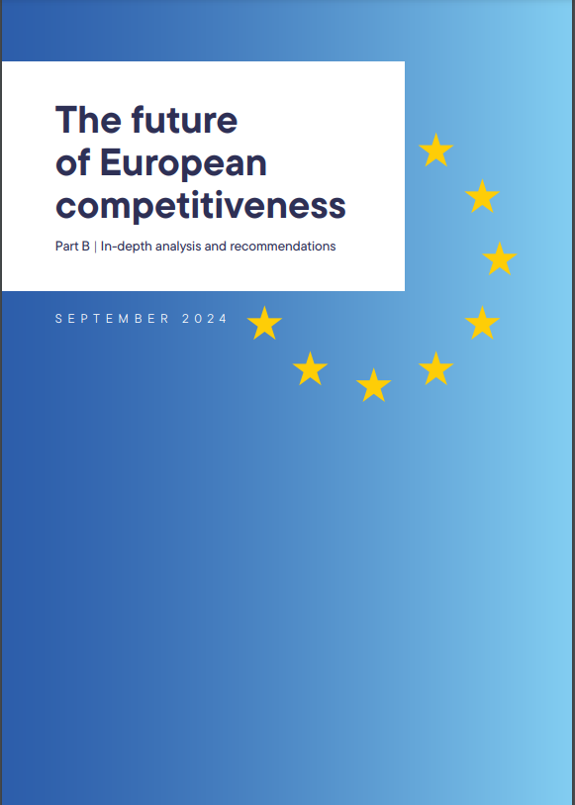
Recommendations
Need for more structured legal tests and appropriate proxies, premises and presumptions that will strengthen legal certainty and administrability and will allow for the integration of more ‘forward-looking’ and ‘systemic’ considerations in the analysis
Need for legal concepts and tests that are not ‘tied’ to a specific economic paradigm, to the extent possible
Need for a New Competition Tool where case-by-case post-conduct enforcement might not be effective

Slide 24

Looking ahead
Still, EU antitrust law cannot do it all.
Need for effective use of all available tools, including EU merger control, the Digital Markets Act, the GDPR, the Data Act, consumer protection rules, etc.
Need for increased inter-institutional cooperation

Slide 25
Thank you!
Dr Andriani Kalintiri
Senior Lecturer in Competition Law
andriani.kalintiri@kcl.ac.uk
https://www.kcl.ac.uk/people/andriani-kalintiri
© 2024 King’s College London. All rights reserved

