Slide 1

EU integration under attack:
How can new interdisciplinary perspectives on EU law enhance the debate?
Dr Brigitte Leucht, University of Portsmouth

Slide 2

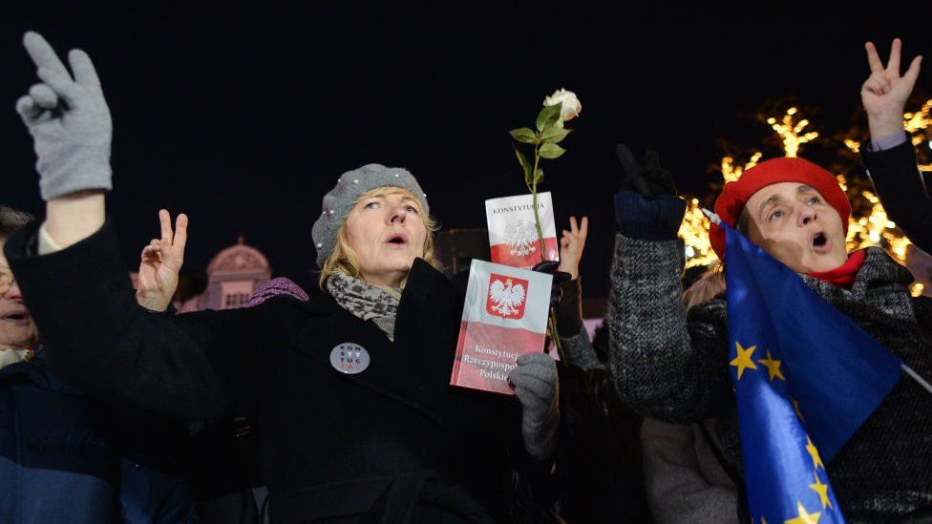
EU integration under attack:
Popular legitimacy of EU (law)?
Nationalism / populism
Weak democratic credentials of the EU
  QMV > policy areas
  Policy direction of EU not determined at EP elections
➔
Analysts’ perspectives: interrogating progressive accounts of EU integration / experiences of legal and market integration

Slide 3
Benefits of a temporal approach to examine the impact of EU law and policy
… on Europeans and on European societies
Evaluate existing work by lawyers, social scientists, and historians on the study of EU law over time.
Ongoing research project on how consumers have experienced the creation of the EC common market from the 1970s

Slide 4

Historians: ‘latecomers’ to study of EU law
Archives of the CJEU opened and made available in the Historical Archives of the EU at the EUI in December 2015.
Historians of European integration focused for a long time on diplomatic and economic history.
Traditionally, legal history has been the domain of lawyers.
Legal history has never been institutionalised in History Departments.

Slide 5

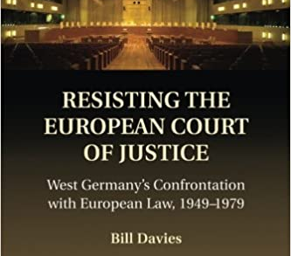
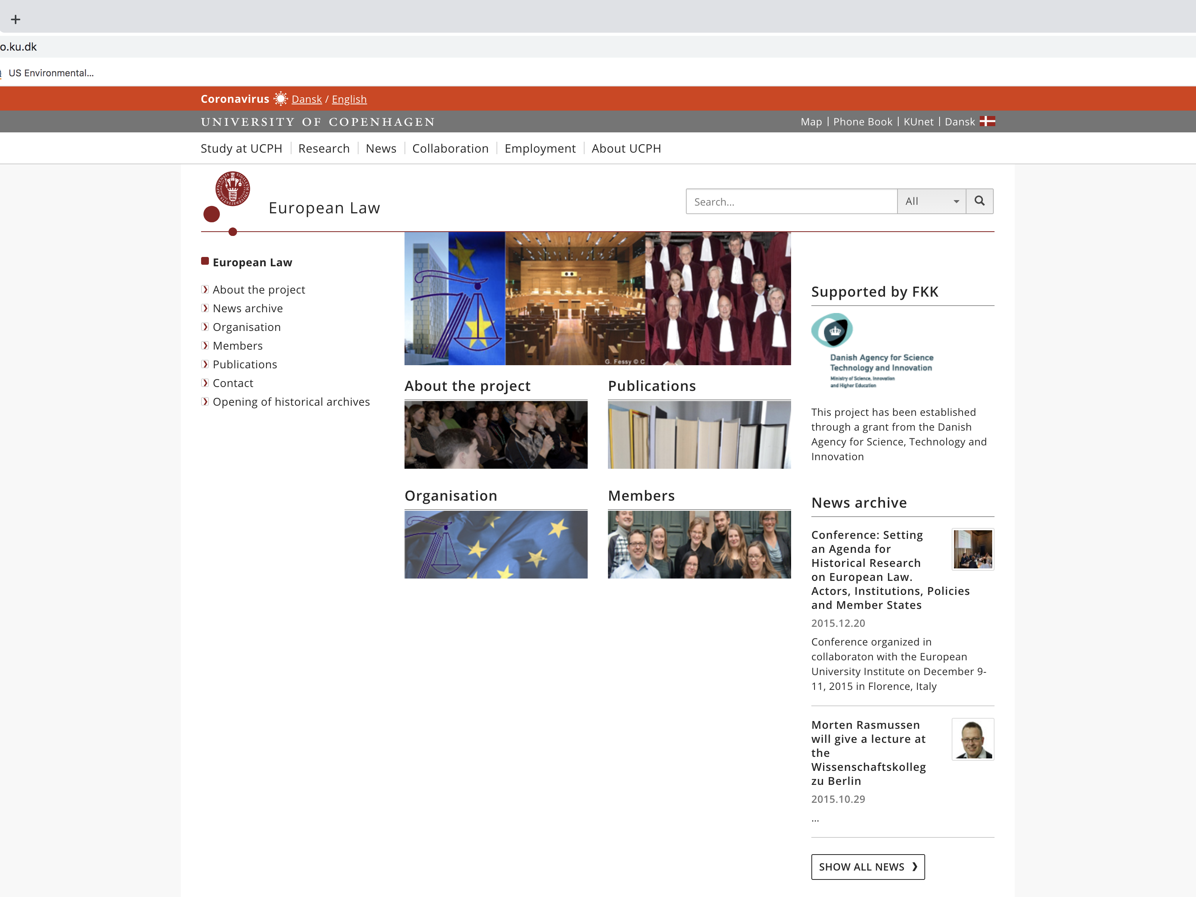
Archive-based perspectives on study of EU law over time
Antoine Vauchez
Bill Davies
Morten Rasmussen /Anne Boerger / Karin van Leeuwen / Vera Fritz / Rebekka Byberg / Jonas Pedersen / Alexandre Bernier

Slide 6
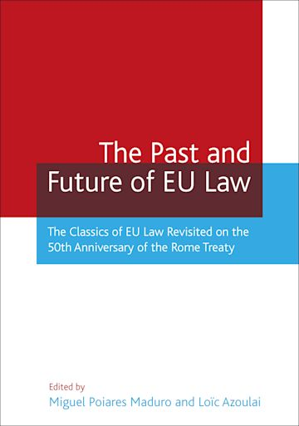

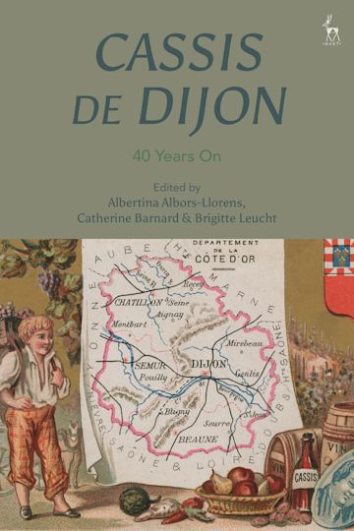

Collective, interdisciplinary volumes

Slide 7
The study of EU law over time –
What we know
And what is missing
From the 1960s, the CJEU established a ‘constitutional practice’
  Support of pro-European judges and civil servants in European institutions and the member states,
  Asserting quasi-constitutional character of the treaties establishing the EC.
Focus on the origins of Cassis de Dijon
  Role of the CJEU in paving the way for launch of the single market programme.
How EC legal and market integration changed European societies and impacted on the lives of Europeans.
Historians have not systematically challenged, or changed, the research agendas set by lawyers and political scientists.

Slide 8

New trends
‘…we lack the geographical and social map of EU law’s embeddedness in European societies’ (A. Vauchez, editorial, Maastricht Journal of European and Comparative Law, 2020)
Focus on litigation
J. Joevenaars 2020 / Lola Avril 2019 / Daniel Kelemen & Tommaso Pavone 2018 / Mala Loth 2021
Focus on interest groups
My research on consumer groups (funded by a British Academy-Leverhulme small research grant)
Diffuse
Framed within dynamics of market integration
1979-1992

Slide 9
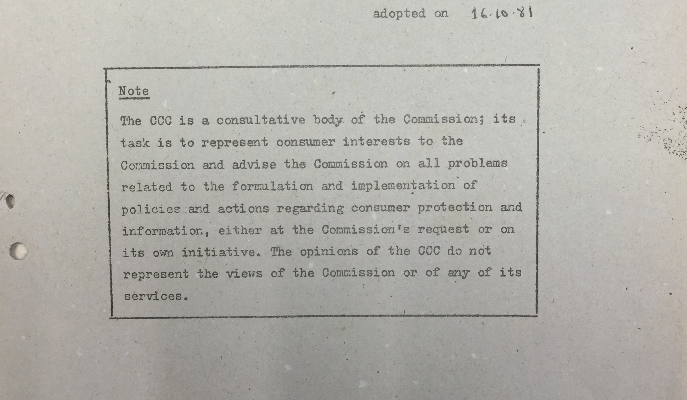
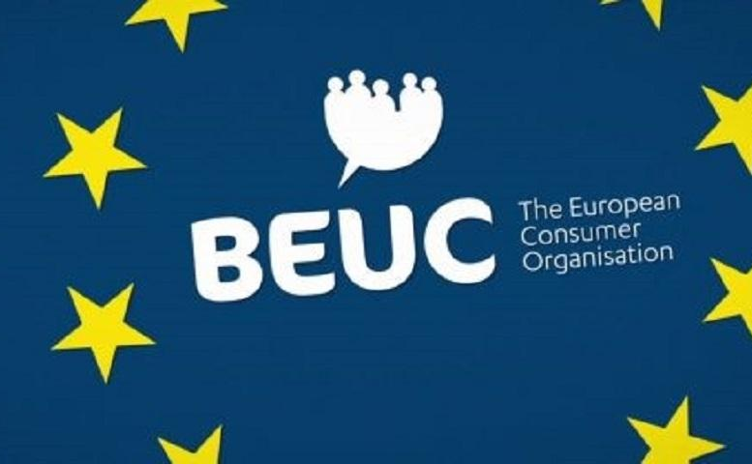
Strategy 1 – archival sources re debates on Cassis de Dijon in the European Commission
Consumers’ Consultative Committee
Jeopardize consumer protection at MS level
Consumer interests consulted in operation of new approach?
‘Race to the bottom’ (vs. potential to maintain regional variations)
Vs. BEUC: potential of Cassis de Dijon to highlight benefits of market integration to consumers
➔ A mixed response to the Commission’s new approach

Slide 10

Strategy 2 – social/cultural history sources: Which? magazine
Testing > consumer policy
Value for money / risks to health and safety
Ca. 600.000 readers, late 1960s
Middle-classed / middle-aged

Slide 11
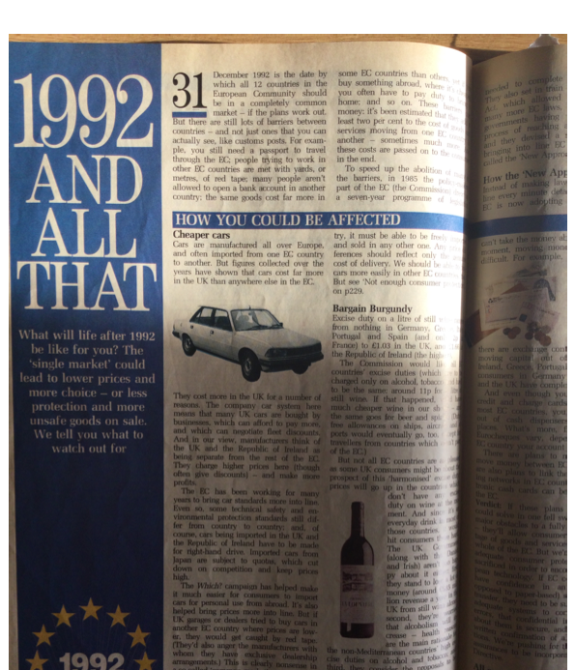
Preliminary findings
Which? 1979-82 & 1988-1992
Lack of letters to the editor on EC common market
Information campaign, lead-up to 1992
  Benefits and pitfalls of joining EC common market for British consumers
  Non-economic benefits of studying and working abroad
Common market in agricultural goods, 1980
  Price hike for milk
  Doorstep delivery uneconomic?

Slide 12
Preliminary analysis suggests –
Periodization
Stretch time frame to examine impact of changes in law and policy on society
‘Shades of grey’
Acceptance / resistance / indifference
Approaching drawing ‘the geographical and social map of EU law’s embeddedness in European societies’

Slide 13
Conclusions
Back to where we started: EU integration under attack
  Euro-skepticism > mainstream // weak democratic credentials
  Boundaries of jurisdiction CJEU
Interdisciplinary perspectives can enhance the debate by –
Introducing tools to assessing the impact of EU law and policy over time: use of archival and social/cultural history sources
Adopting ‘bottom-up’ perspectives on the popular experiences of legal arrangements over time: the notion of indifference / substantiated with empirical evidence
Focus on the historical experiences of EU citizens – a more fully drawn ‘geographical and social map of EU law’s embeddedness in European societies’ – as a pre-requisite for institutional reform?

